Slide 1

Quant Week 7
3/28/24
Notes:
Complete

Slide 2

Agenda
Icebreaker Question
Brainteasers
Useful Classes
VWAP & TWAP
Project

Slide 3
Ice Breaker
Tell us a weird fact you happen to know for no reason.

Slide 4


IMC Sponsorship!
Referal Code: 3MRLW8

Slide 5
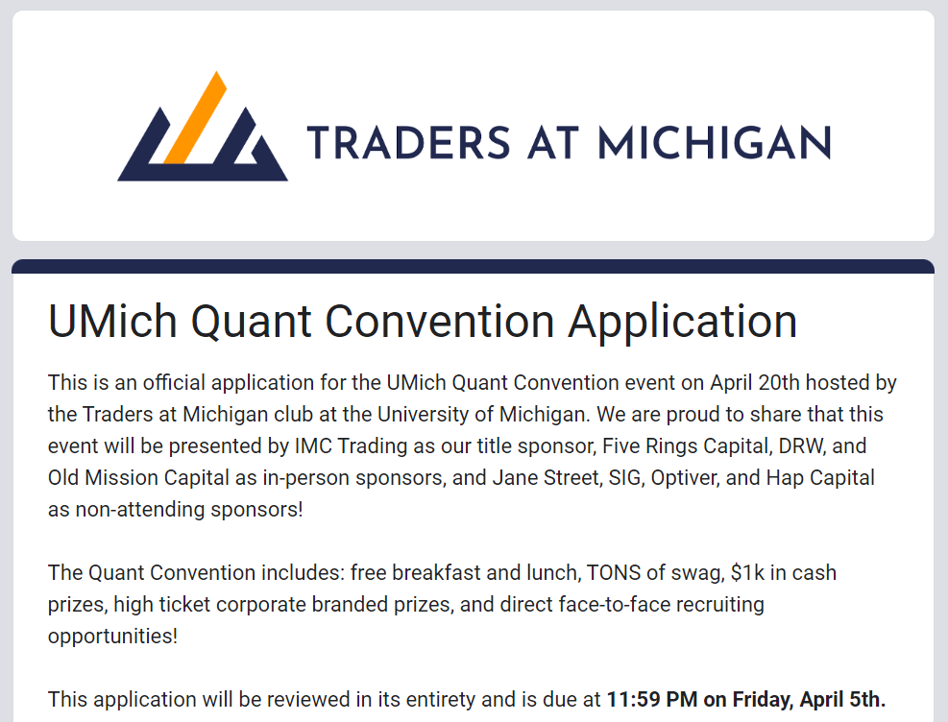
Quant Conference
https://docs.google.com/forms/d/e/1FAIpQLScZRTzsPrafhUgLAJVF5GTdyxekcqPIVC9TeYD-JrGRv0M0UQ/viewform
April 5th!

Slide 6
IMC Sponsorship!
Sophomores, apply to IMC Launchpad:
https://careers.imc.com/us/en/launchpad
Great opportunity to learn
If you get in, IMC gives you a final round internship interview
IMC Event
Time/Date TBD

Slide 7
Brain Teaser - Door to Offer
You are in a room with two doors. One door leads to freedom, the other leads to certain death.
There is a guard guarding either door. One can only lie and one can only tell the truth.
You may ask ONE of the guards one yes or no question

Slide 8
Brain Teaser - Door to Offer - Solution
Game Theory
Draw out each possibility
Ask a question involving both guards
Ask, “Would the other guard say that you are guarding the door to freedom?”
Many answers

Slide 9
Brain Teaser - Biased Coin Sequence
You are given a coin with ⅔ probability of landing on heads and ⅓ probability of landing on tails. If you flip this coin until you get tails immediately followed by heads, how many times do you expect to flip the coin?

Slide 10
Solution - Biased Coin Sequence
Considering only the first flip, if it lands on heads, we have made no progress. That is, the expected value given the first flip was heads is just the expected value of the event plus 1: E[TH | H] = E[TH] + 1.
If it lands on tails, we now just need a heads at some point following the tails, which is a geometric series with expected value 1/p:E[TH | T] = 3/2 + 1.
Using the law of total expectation:
E[TH] = P(H)E[TH | H] + P(T)E[TH | T] = ⅔(E[TH] + 1) + ⅓(3/2 + 1)
E[TH] = ⅔ E[TH] + ⅔ + ⅚
⅓ E[TH] = 9/6
E[TH] = 9/2

Slide 11
Useful Classes
Trading (ish)
Math 425 - Introduction to Probability (absolutely necessary for trading)
Math 423 - Mathematics of Finance (covers futures/options pricing)
Math 525 - Probability Theory (useful for understanding, not 100% necessary)
Math 623 - Computational Finance (focused on Quant Masters program and is brutal)
Math 507? Mathematical Methods for Algo Trading (apparently reserved for Quant program, not sure if you can override)
Finance 302 - Ross intro Finance class
Finance 408 - Shorting, Margin calls, ETFs, Mutual Funds
Finance 440 - Financial Trading (hands-on experience day-trading in a market)
SWE
EECS 281 - Data Structures and Algorithms
EECS 370 - Intro to Computer Organization
EECS 482 - Operating Systems (disclaimer: not for the faint of heart)

Slide 12
Schedule-Based Single Order Algorithms
Notes:
Idea:
We’ll write the platform to make and conduct trading strategies.
You guys will write and implement the strategies, test them on prior data
Alternate for more software-oriented people you guys could also make the platform
We can do this in python/C++, if python use numPy and Yahoo Finance data
Use matplotlib plot graphs, show that in pdf/md/html file through github

Slide 13
Let’s say you are a trader and your firm wants to buy (or sell) a large volume of a single stock quickly.
A large volume in this context is one that will change the price
2 main order types exist, market orders and limit orders

Slide 14
Order Book Example, Market Order of 1000
Bid (Volume) | Price | Ask (Volume)
 | 100.05 | 350
 | 100.04 | 450
 | 100.03 | 200
 | 100.02 | 150
 | 100.01 | 50
120 | 100.00
180 | 99.99

Slide 15
Order Book Example, Market Order of 1000
Bid (Volume) | Price | Ask (Volume)
 | 100.05 | 350 (150 SOLD)
 | 100.04 | 450 (SOLD)
 | 100.03 | 200 (SOLD)
 | 100.02 | 150 (SOLD)
 | 100.01 | 50 (SOLD)
120 | 100.00
180 | 99.99

Slide 16
Order Book Example
Bid (Volume) | Price | Ask (Volume)
 | 100.05 | 200
 | 100.04
 | 100.03
 | 100.02
 | 100.01
120 | 100.00
180 | 99.99

Slide 17
As you can see, the best ask when the market order was placed was 10.01.
Some orders went through at this price, but not all of them.
Some went through as high as 10.05.

Slide 18
Order Book Example
Bid (Volume) | Price | Ask (Volume)
 | 120.01
 | 120.00 | 200
 | ….
 | 100.10 | 50
 | 100.09 | 50
 | 100.08 | 50
 | 100.07 | 60
 | 100.06 | 40
 | 100.05 | 50
 | 100.04 | 200
 | 100.03 | 100
 | 100.02 | 100
 | 100.01 | 100
120 | 100.00
180 | 99.99

Slide 19
Order Book Example
Bid (Volume) | Price | Ask (Volume)
 | 120.01
 | 120.00 | 200 (SOLD)
 | ….
 | 100.10 | 50 (SOLD)
 | 100.09 | 50 (SOLD)
 | 100.08 | 50 (SOLD)
 | 100.07 | 60 (SOLD)
 | 100.06 | 40 (SOLD)
 | 100.05 | 50 (SOLD)
 | 100.04 | 200 (SOLD)
 | 100.03 | 100 (SOLD)
 | 100.02 | 100 (SOLD)
 | 100.01 | 100 (SOLD)
120 | 100.00
180 | 99.99
For a larger example, if there is not much demand at all, transacting may lead to much higher prices.
Here some orders are placed at $120 because the market is “thin”
thin means relatively few buyers/sellers

Slide 20
Order Book Example, Limit Order of 1000
Bid (Volume) | Price | Ask (Volume)
 | 100.05 | 350
 | 100.04 | 450
 | 100.03 | 200
 | 100.02 | 150
 | 100.01 | 50
120 | 100.00
180 | 99.99

Slide 21
Order Book Example, Limit Order of 1000
Bid (Volume) | Price | Ask (Volume)
 | 100.05 | 350
 | 100.04 | 450
 | 100.03 | 200
 | 100.02 | 150
 | 100.01 | 50
1,120 (1,000 Yours) | 100.00
180 | 99.99

Slide 22
People will be able to see that you placed this order, and others will try to “front run” your order
Others know this order is likely to make prices go up so others will try to buy
They see your order exists and has not transacted yet, so they will try to beat you to it by buying one cent above you
This makes YOU lose out on profits!

Slide 23
How to avoid these things
Use a combination of both market and limit orders
Sell over time
2 strategies: TWAP & VWAP

Slide 24
TWAP & VWAP
TWAP - Time-Weighted Average Price
Buy/Sell a handful of the stock in intervals
This way others won’t see your large limit orders, and market orders will (hopefully) get better prices
VWAP - Volume-Weighted Average Price
Match the intervals to corresponding trading volume

Slide 25
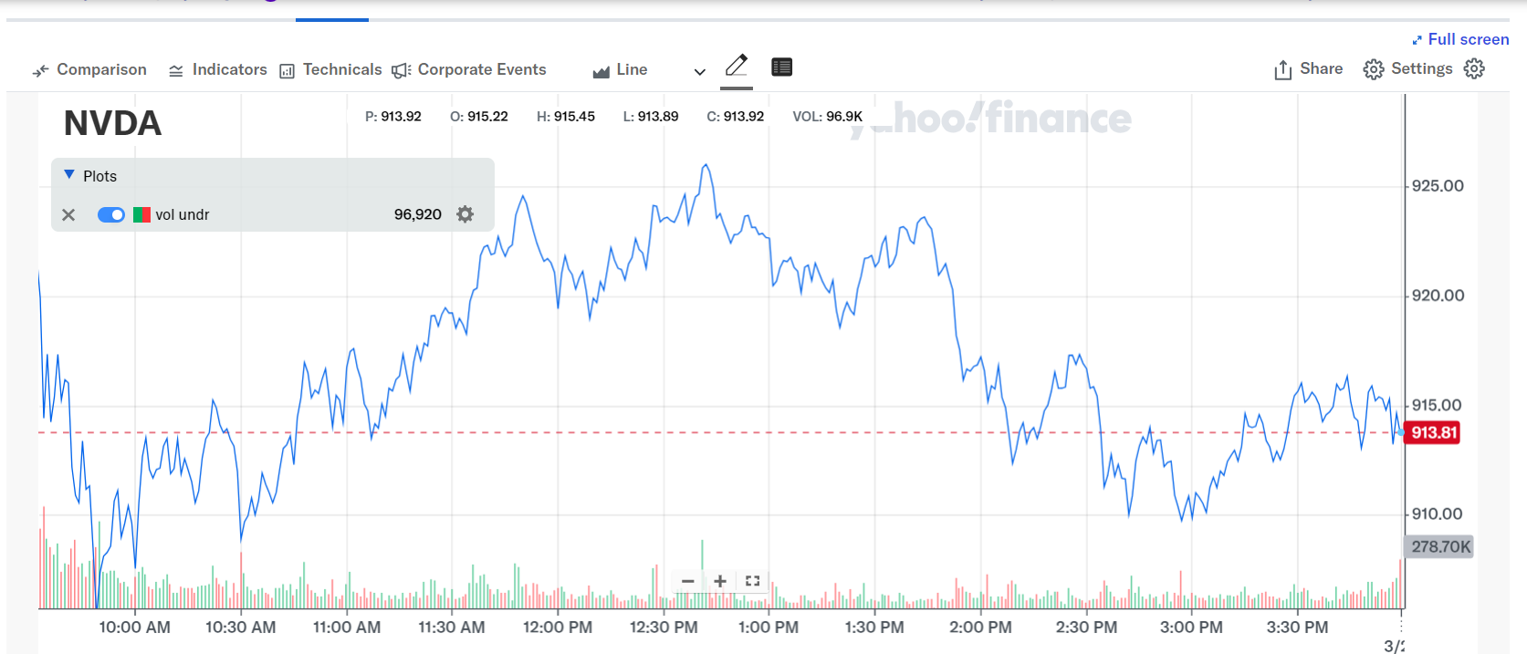

Slide 26
Project Discussion/Work Time
Notes:
Idea:
We’ll write the platform to make and conduct trading strategies.
You guys will write and implement the strategies, test them on prior data
Alternate for more software-oriented people you guys could also make the platform
We can do this in python/C++, if python use numPy and Yahoo Finance data
Use matplotlib plot graphs, show that in pdf/md/html file through github

Slide 27
Current Environment
As of right now, we’ll use Google Drive/Colab
.py files stored in the drive, need to be implemented
.ipynb file for driver, also needs to be implemented
Hoping to move to git/github and conda environments soon
Review the guide and setup your python and conda environments accordingly
If you get stuck, I will be available to help out next week outside of our normal meeting
Note: if you’re new to Python or need to brush up, check out
https://www.kaggle.com/learn/python

Slide 28
Calculating Variance and Sharpe of PnL
Variance
Given the list of trades, translate this into the raw PnL
Call .pct_change() on the pandas dataframe containing PnL to get returns
Call var() on the returns dataframe to get the variance of returns
Sharpe Ratio = E[Rp - Rf] / σ
Calculate portfolio returns (initial - final / initial)
Acquire Risk Free Rate (use 5% for now or acquire it from US Treasuries)
Adjust the RFR for the time period
Divide by the square root of the variance (standard deviation)

Slide 29
Attendance Form
This one
Link to Onboarding Document, Slack and Team Folder
https://tinyurl.com/2fk3aemj
https://docs.google.com/document/d/1oA2q-qjPCw1bY79zWf1LtpeN_da65L0ntnxzCQSsJRc/edit?usp=sharing

